Slide 1

Rating prediction PROJECT
Nazia Sultana Khan

Slide 2
Agenda
Overview.
Problem Statement.
Problem Understanding.
What is Rating Prediction?
Importance of Rating Prediction Project.
Data Analysis and Model Building Flow Chart.
Exploratory data analysis.
Visualizations.
Analysis.
Model Building.
Model Comparison
Interpretation Of Result
Hyper Parameter Tunning.
Conclusion.

Slide 3
Overview
In this particular presentation we will be looking on :
How to analyze the dataset of Rating Prediction Project.
What are the EDA steps in cleaning the dataset.
Overall analysis on the problem.
Model building from the cleaned dataset.
Saving the best model.

Slide 4

Problem Statement
We have a client who has a website where people write different reviews for technical products. Now they are adding a new feature to their website i.e. The reviewer will have to add stars(rating) as well with the review. The rating is out of 5 stars and it only has 5 options available 1 star, 2 stars, 3 stars, 4 stars, 5 stars. Now they want to predict ratings for the reviews which were written in the past and they don’t have a rating. So, we have to build an application which can predict the rating by seeing the review.

Slide 5
Problem Understanding
Rating prediction is a well-known recommendation task aiming to predict a user’s rating for those items which were not rated yet by her. Predictions are computed from users’ explicit feedback, i.e. their ratings provided on some items in the past. Another type of feedback are user reviews provided on items which implicitly express users’ opinions on items. Recent studies indicate that opinions inferred from users’ reviews on items are strong predictors of user’s implicit feedback or even ratings and thus, should be utilized in computation.

Slide 6
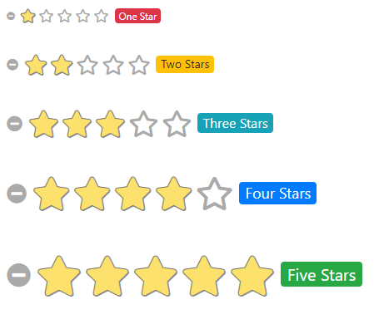
Problem Understanding

Slide 7

What is Rating Prediction?
Rating prediction is a well-known recommendation task aiming to predict a user's rating for those items which were not rated yet by her. Predictions are computed from users' explicit feedback, i.e. their ratings provided on some items in the past

Slide 8
Importance of Rating Prediction Project
1. The rise of E-commerce business has brought a significant rise in the
importance of customer reviews.
2. There are hundreds of review sites online and massive amounts of reviews for
every product.
3. Customers have changed their way of shopping and according to a recent
survey, 70 percent of customers say that they use rating filters to filter out low
rated items in their searches.
4. The ability to successfully decide whether a review will be helpful to other
customers and thus give the product more exposure is vital to companies that
support these reviews.
5. There are two main methods to approach this problem.
6. The first one is based on review text content analysis and uses the principles
of natural language process.
7. This method lacks the insights that can be drawn from the relationship
between costumers and items.
8. The second one is based on recommender systems, specifically on collaborative
filtering, and focuses on the reviewer’s point of view.

Slide 9
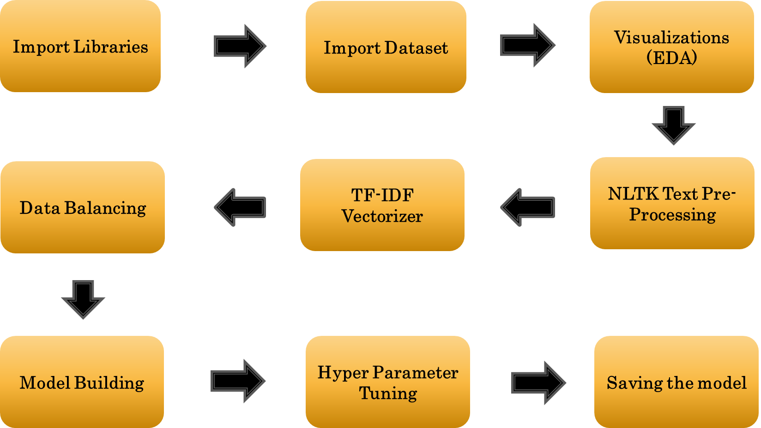
Data Analysis and Model Building Flow Chart

Slide 10
Exploratory data analysis
Importing necessary libraries and loading dataset as a data frame.
Checked some statistical information like shape, number of unique values present, info, null values, value counts etc.
Checked for null values and I replaced those null values using imputation method. And removed Unnamed: 0 and Unnamed:1.
Visualized each feature using seaborn and matplotlib libraries by plotting distribution plot and word cloud for each ratings.
Done text pre-processing techniques like Removing Punctuations and other special characters, Splitting the comments into individual words, Removing Stop Words, Stemming and Lemmatization.
After getting a cleaned data used TF-IDF vectorizer. It’ll help to transform the text data to feature vector which can be used as input in our 6 modelling. It is a common algorithm to transform text into numbers. It measures the originality of a word by comparing the frequency of appearance of a word in a document with the number of documents the words appear in.

Slide 11
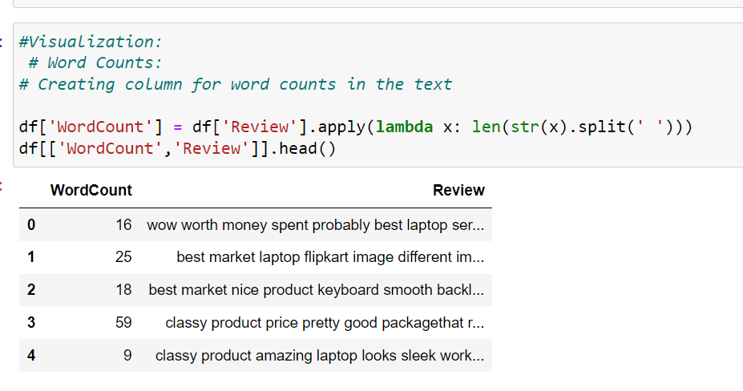
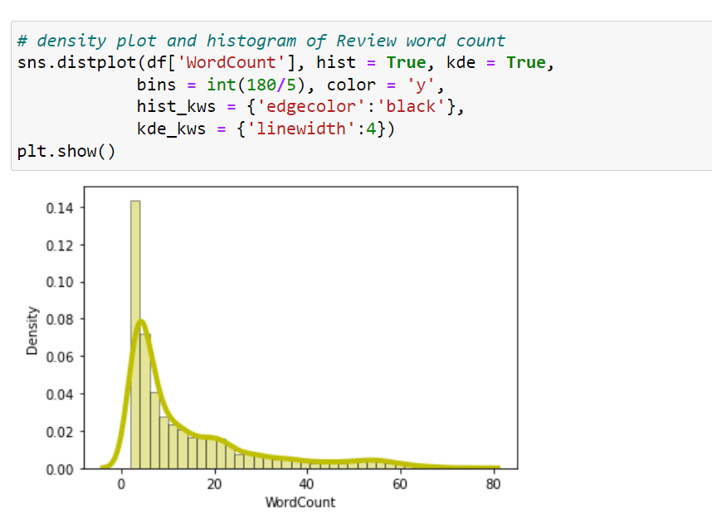
Visualization
By observing the histogram we can clearly see that most of our text is having the number of words in the range of 0 to 80, But some of the reviews are too lengthy which may act like outliers in our data.
Above plot represents histogram for character count of Review text, which is quite similar to the histogram of word count.

Slide 12
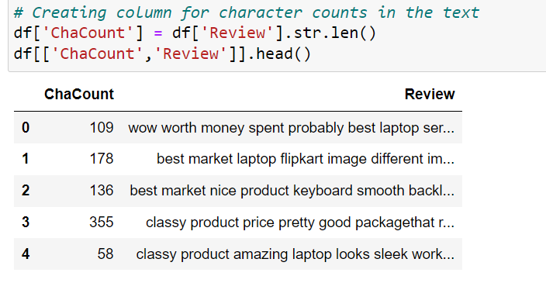
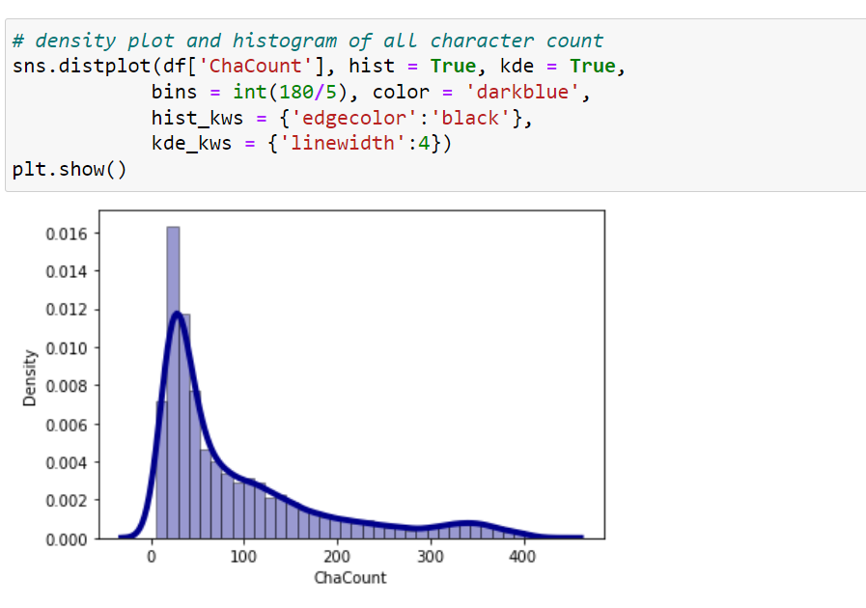
Visualization
Above plot represents histogram for character count of Review text, which is quite similar to the histogram of word count.
By observing the histogram we can clearly see that most of our text is having the number of words in the range of 0 to 400, But some of the reviews are too lengthy which may act like outliers in our data

Slide 13
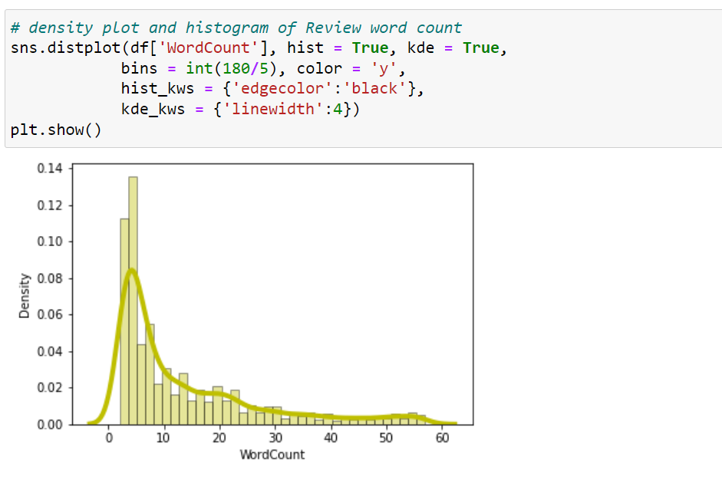
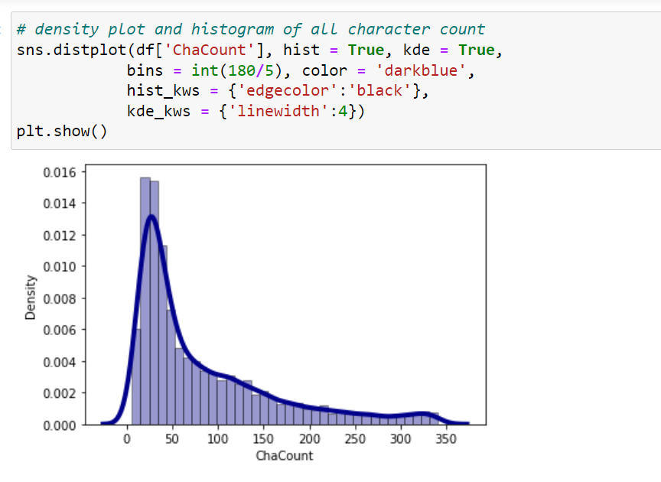
Visualization
As we know that some of the review are too lengthy, so i have to treat them as outliers and remove them using z_score method. After removing the outliers the word count and character count looks as below.
After plotting histograms for word counts and character counts and after removing outliers we can see we are left out with good range of number of words and characters

Slide 14
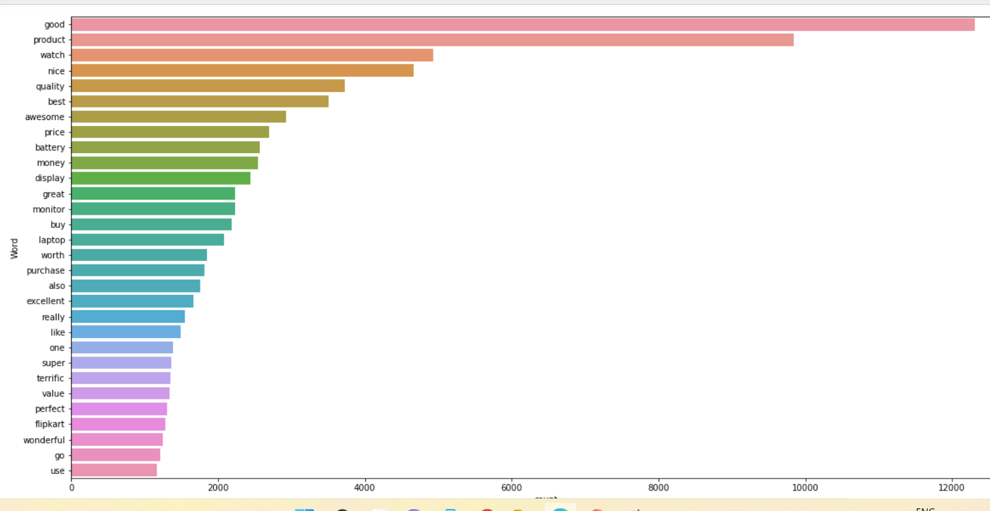
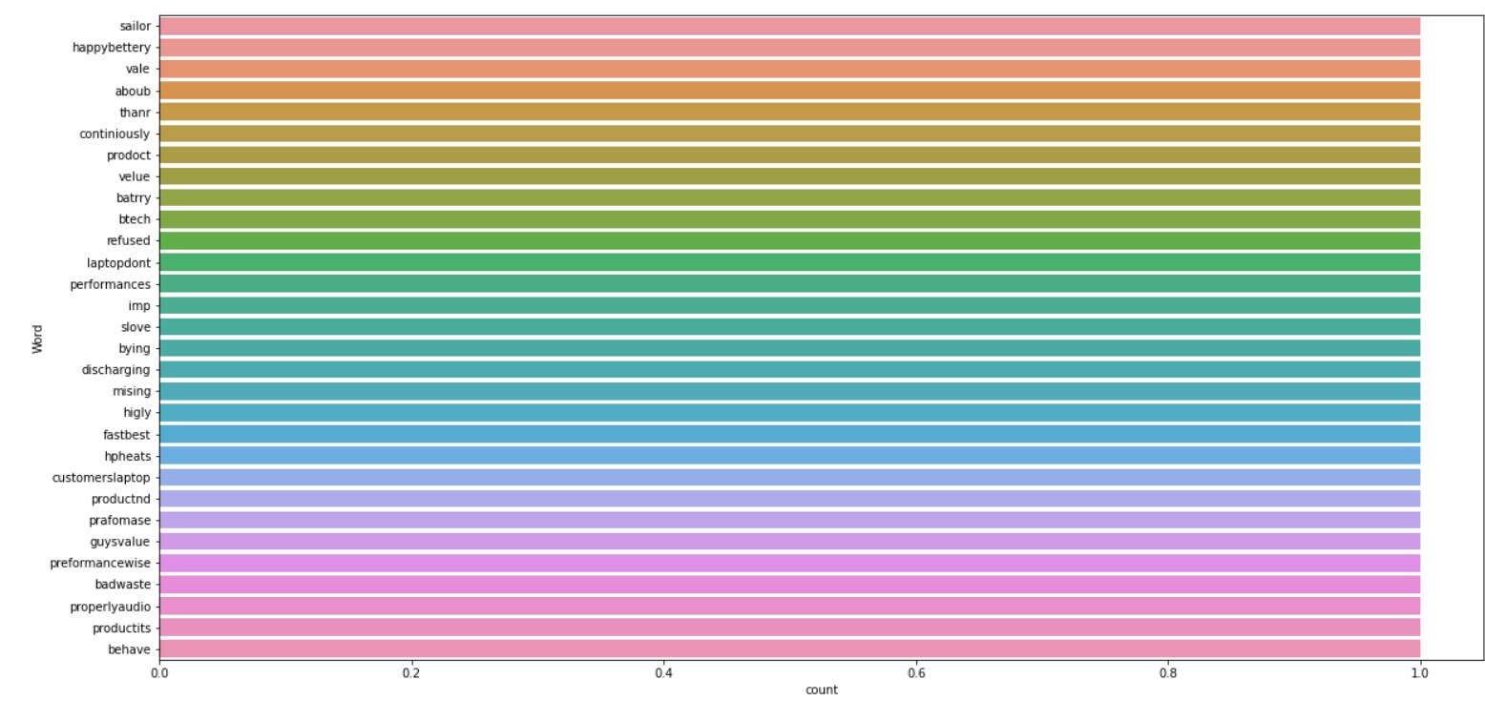
Visualization
By seeing the above plot we can see that Good, product, quality......are occurring frequently. And the second plot shows rarely occurring words

Slide 15
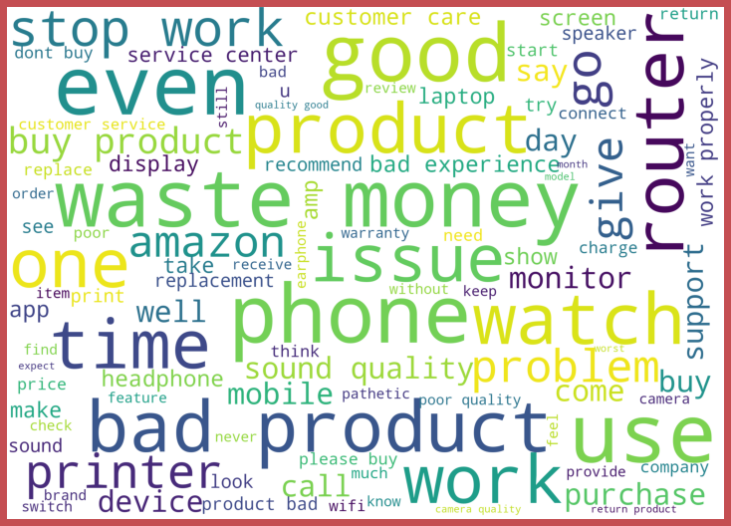
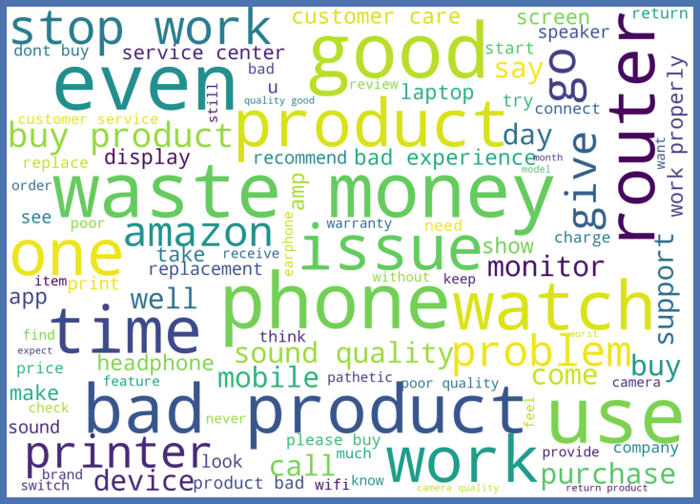
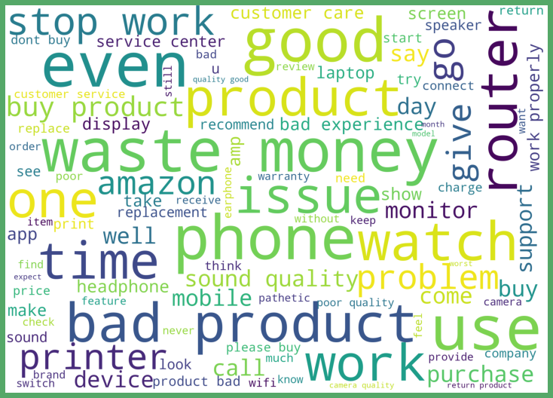
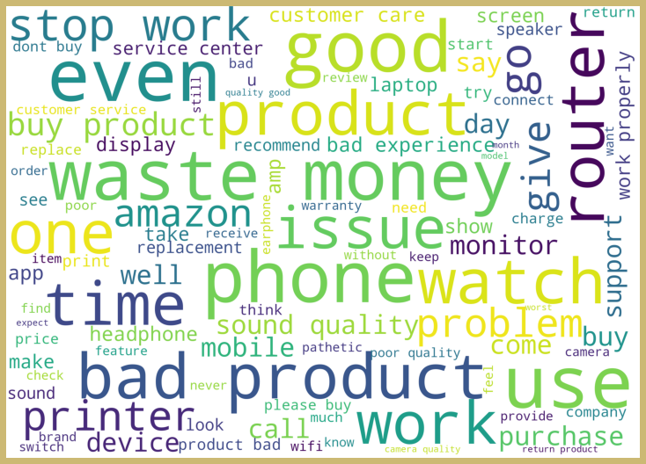

Visualization
From the above plots we can clearly see the words which are indication of Reviewer's opinion on products.
Here most frequent words used for each Rating is displayed in the word cloud.

Slide 16
Analysis
This project is more about exploration, feature engineering and classification that can be done on this data. Since the data set is huge and includes multiclassification of ratings, we can do good amount of data exploration and derive some interesting features using the review text column available.
Just make the reviews more appropriate so that we’ll get less word to process and get more accuracy.
Removed extra spaces, converted email address into email keyword, likely wise phone number etc. Tried to make Reviews small and more appropriate as much as it was possible.
After getting a cleaned data used TF-IDF vectorizer. It’ll help to transform the text data to feature vector which can be used as input in our modelling. It is a common algorithm to transform text into numbers. It measures the originality of a word by comparing the frequency of appearance of a word in a document with the number of documents the words appear in.
Balanced the data using SMOTE mechanism.

Slide 17
Model Building
In this nlp based project we need to predict ratings which are multi-classifiers. I have converted the text into vectors using TFIDF vectorizer and separated our feature and labels then build the model using One Vs Rest Classifier. Among all the algorithms which I have used for this purpose I have chosen SGDClassifier as best suitable algorithm for our final model as it is performing well compared to other algorithms while evaluating with different metrics I have used following algorithms and evaluated them
LinearSVC
LogisticRegression
DecisionTreeClassifier
RandomForestClassifier
XGBClassifier
SGDClassifier
From all of these above models SGDClassifier was giving me good performance.

Slide 18
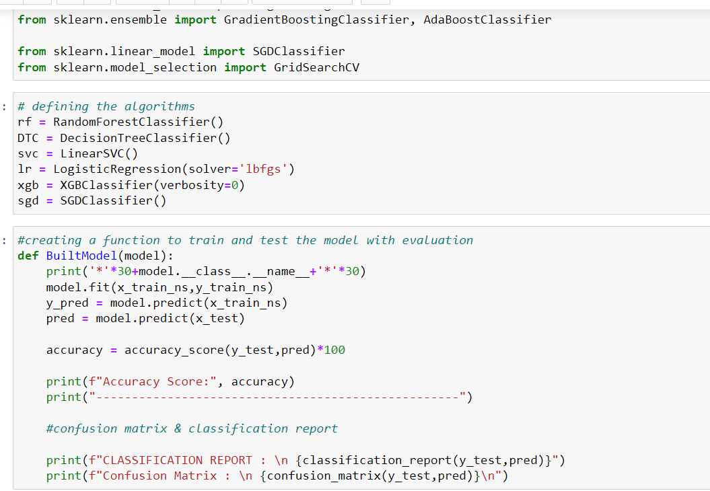
I have used 6 classification algorithms. First, I have created 6 different classification algorithms and are appended in the variable models. Followed by TFIDF vectorization and data balancing. Then, ran a for loop which contained the accuracy of the models along with different evaluation metrics

Slide 19
Model Comparison
ML Algorithm Used | Predicted Score
Random Forest Classifier | 97.4%
Decision Tree Classifier | 96%
SGDClassifier | 97.5%
Linear SVC | 97.7%
Xgboost Classifier | 98.3%
Logistic Regression | 97.6%
To predict the result of this dataset above are classification models used for evaluations.
Out of all the machine learning models used I have selected SGDclassifier model for further evaluation of this dataset.

Slide 20
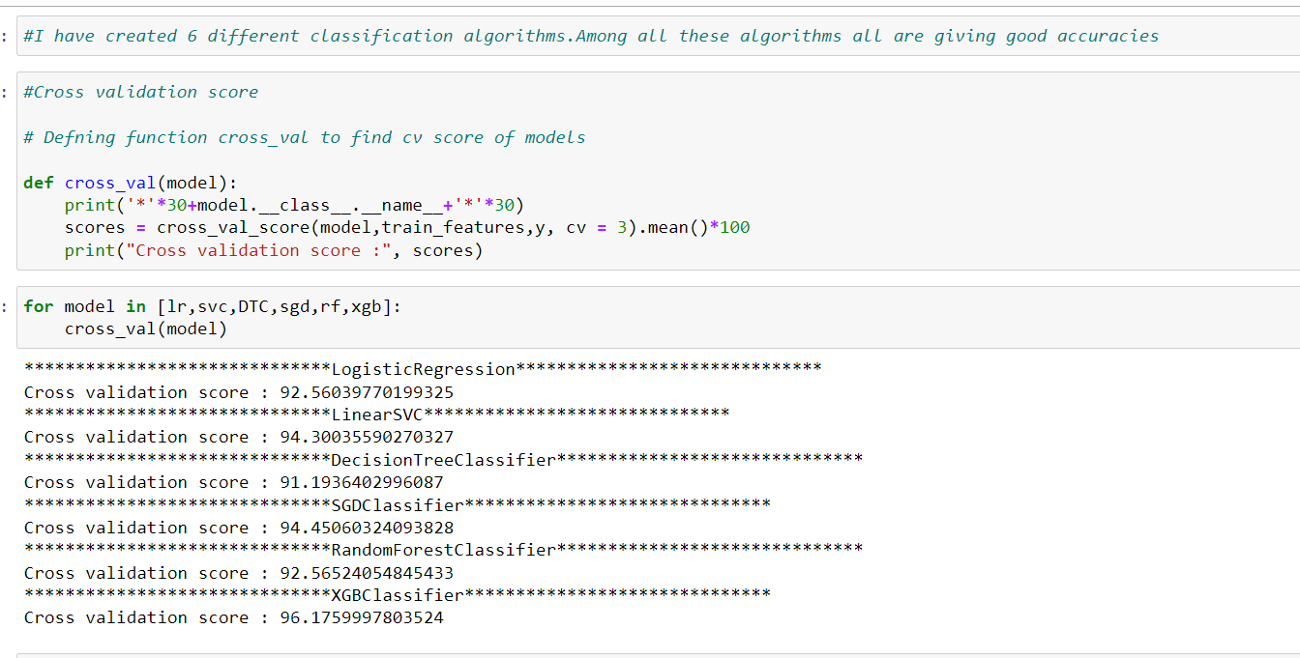
Interpretation Of Result
all our algorithms are giving good cv scores. Among these algorithms I am selecting SGD Classifier as best fitting algorithm for our final model as it is giving least difference between accuracy and cv score

Slide 21
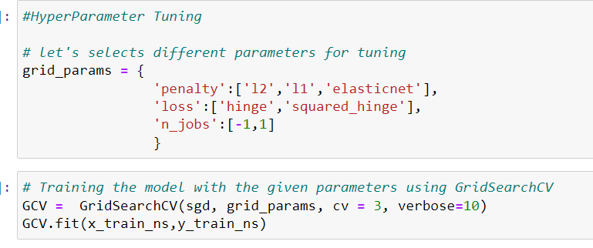
Hyper Parameter Tunning
And after doing hyperparameter tuning I got above parameters as best suitable parameters for our final model.
I have trained my final model using these parameters and it was unable to increase the accuracy of the model.

Slide 22
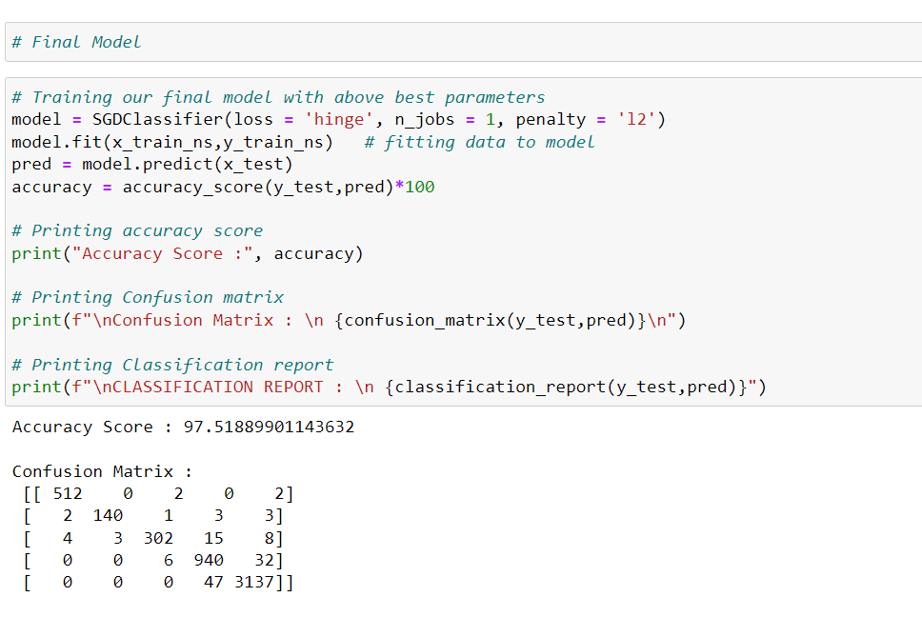
After training and building our final model I saved this model into .pkl file.

Slide 23
Conclusion
In this project report, we have used NLP machine learning algorithms to predict the Ratings. We have mentioned the step by step procedure to analyze the dataset and finding the correlation between the features.
Thus we can select the features which are correlated to each other and are independent in nature. The power of visualization has helped us in understanding the data by graphical representation it has made me to understand what data is trying to say.
Data cleaning is one of the most important steps to remove unrealistic values and unnecessary punctuations, URLs, email address, stop words.
These feature set were then given as an input to 6 algorithms and a hyper parameter tunning was done to the best model. Hence we calculated the performance of each model using different performance metrics and compared them based on these metrics.
Then we have also saved the best model.

Slide 24
Thank You

